Slide 1

Version 2.0 September 2024

Slide 2

Agenda
Introduction
Financial Planning
Insurance and Legal Documents
Saving and Investing
Managing Debt and Credit
Summary and Resources

Slide 3
Financial Planning

Slide 4
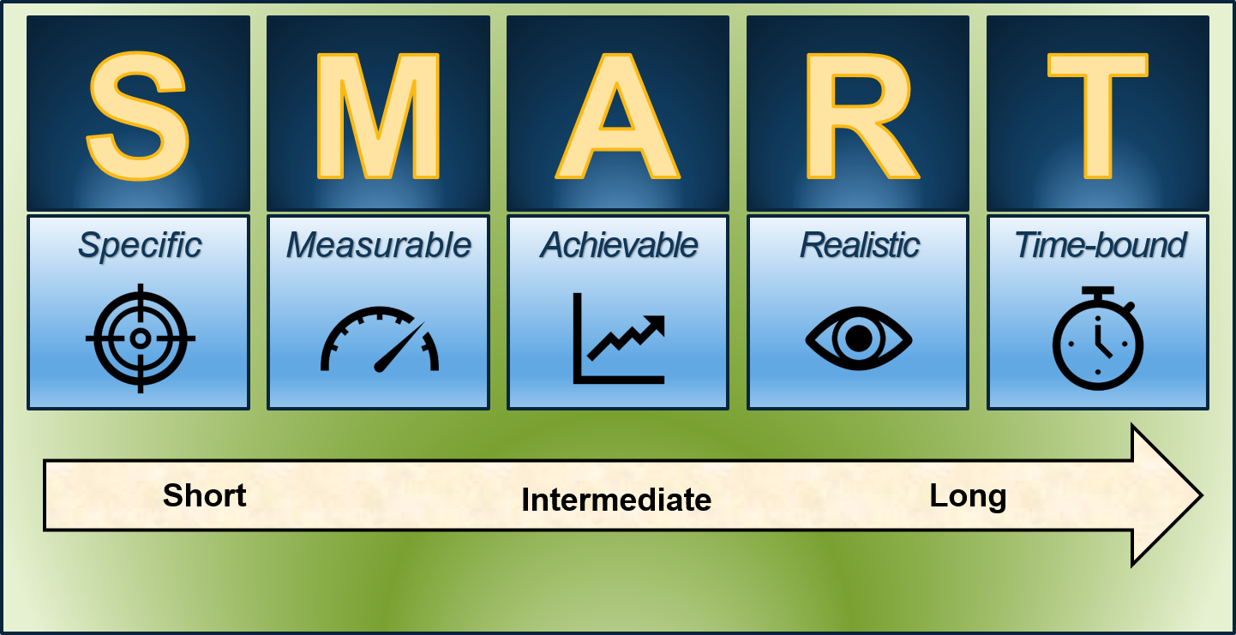
Setting Financial Goals
Why do we set goals?
Review your goals
Turn your goals into SMART goals

Slide 5

SMART Activity
SGT Sanders saved $334 per month for nine months to put a $3,000 down payment on a vehicle.
S.M.A.R.T

Slide 6
Setting Financial Goals
Short-Term
Less than one year, often within weeks
Long-Term
Requires longer commitment
Example: set up an emergency fund of $1,000
Example: buy a car for $15,000

Slide 7
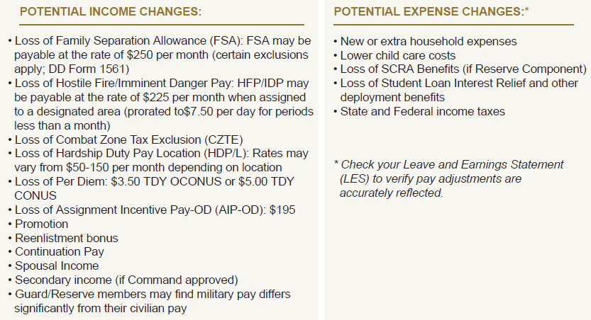
Adjust Spending Plan
Create and update your spending plan
Evaluate and update automatic fund transfers, bill payments and allotments
Account for changes to income, taxes, and expenses

Slide 8
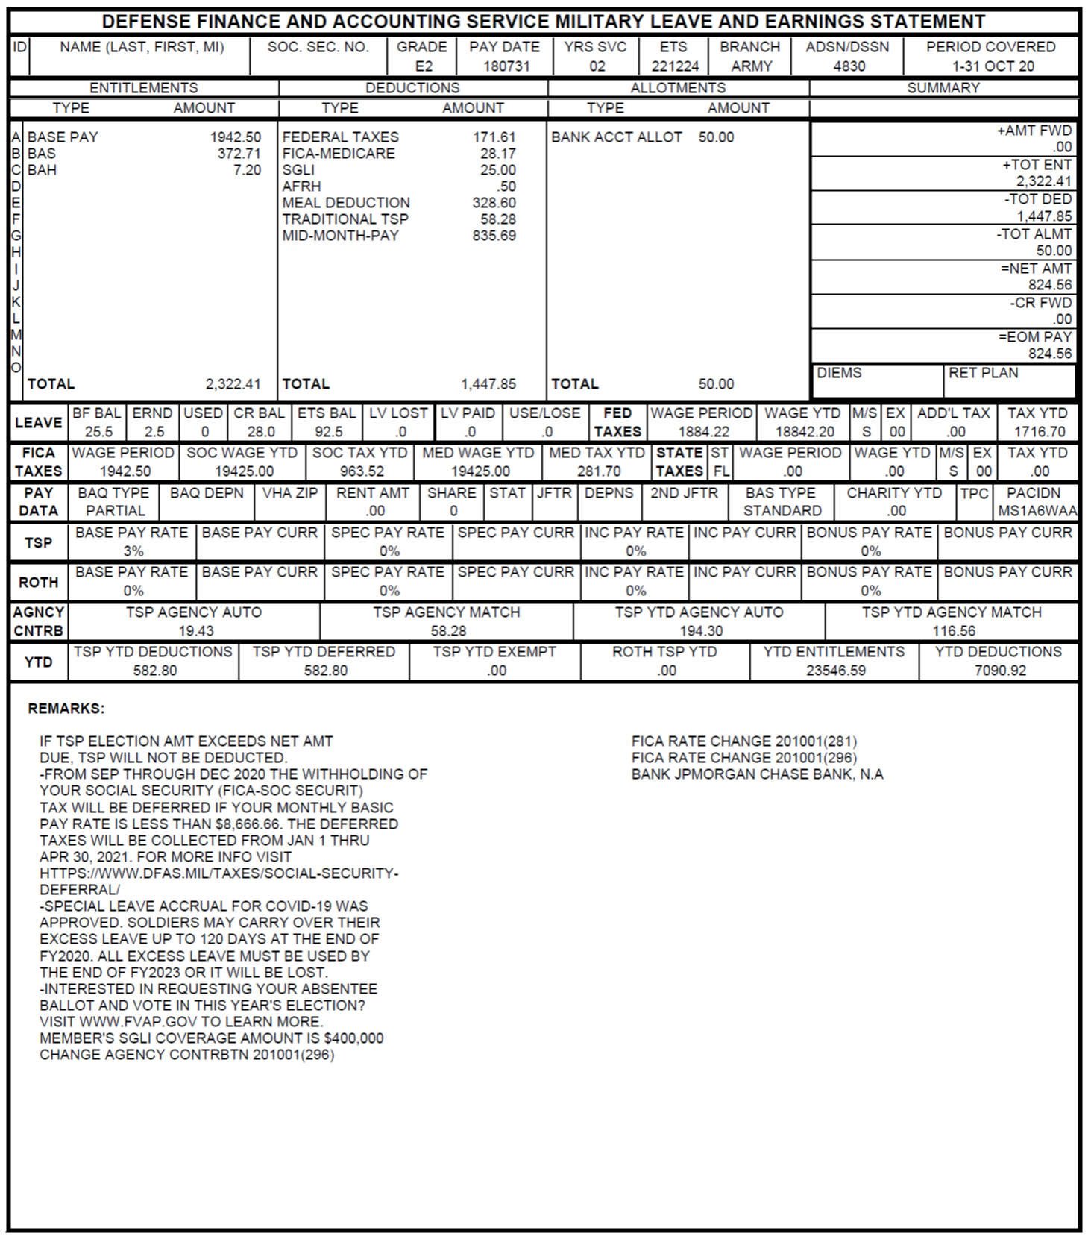
Leave and Earnings Statement
Review your Leave and Earnings Statement (LES)
Review your bank statements

Slide 9
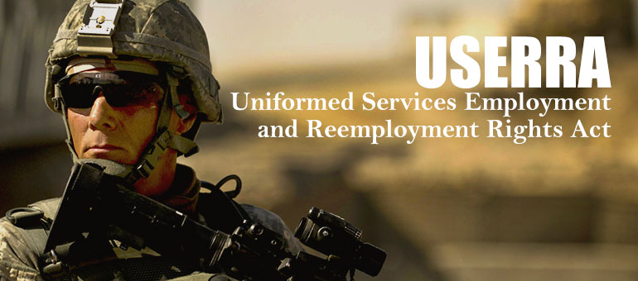
Members of the Guard and Reserve
Review requirements of the Uniformed Services Employment and Reemployment Rights Act (USERRA)

Slide 10

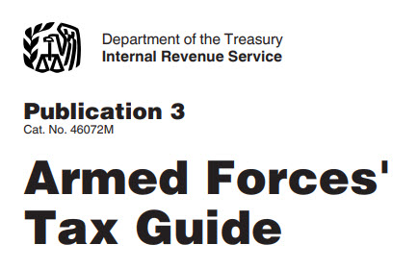
Taxes
Source: https://www.irs.gov/forms-pubs/about-publication-3

Slide 11
Insurance and Legal Documents

Slide 12
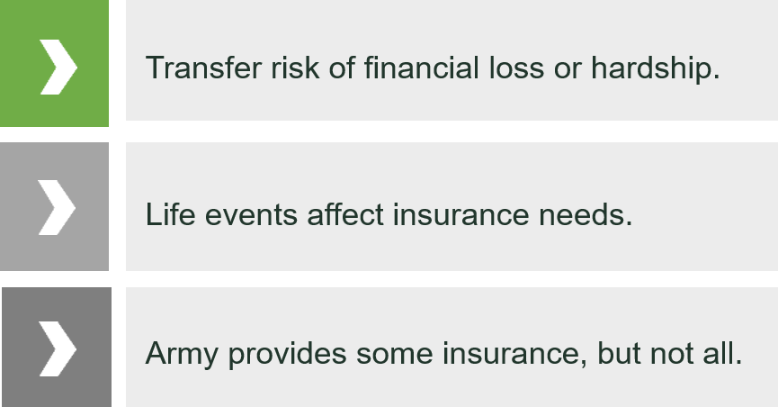
The Purpose of Life Insurance

Slide 13
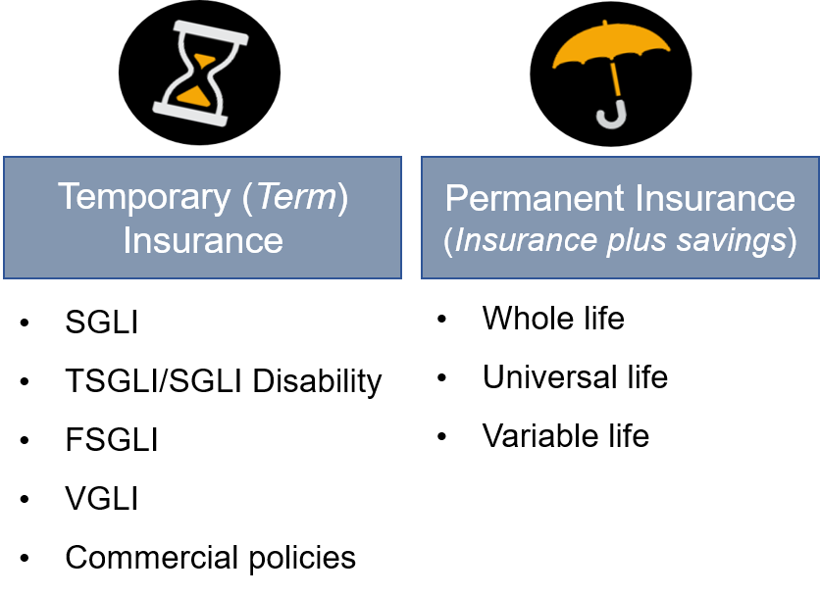


Insurance Overview
Two Types of Insurance
TRICARE
Auto
Homeowners/Renters
Dental

Slide 14
LIFE Insurance Needs
Liabilities (debts and obligations)
Income (amount X number of years needed)
Final expenses
Education and other goals
+
+
+
Subtract current coverage and assets
-
Your Total Need

Slide 15
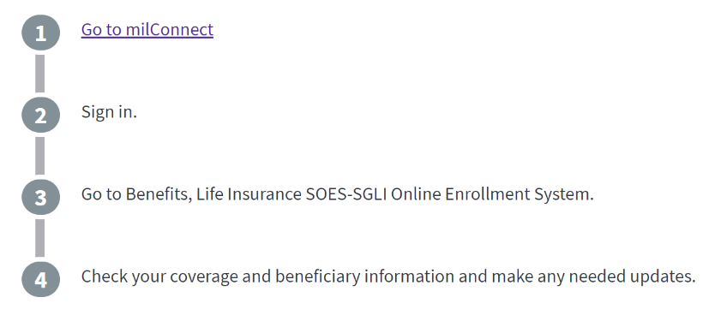

How to Change Your SGLI
SGLI Online Enrollment System (SOES):
Replaces paper-based SGLI enrollment and maintains elections and beneficiary information.
Provides 24/7 self-service SGLI information
www.dmdc.osd.mil/milconnect

Slide 16
Legal Documents
Review and update important documents such as:
  Will
  Power of Attorney
  Living Will
  Medical directives
  DD Form 93
  Form TSP-3
  Religious preference
  Home of record considerations
Safeguard information and documents

Slide 17

Survivor Benefits
Survivor Benefits
  Death Gratuity
  Survivor Benefit Plan (SBP)
  Dependency and Indemnity Compensation (DIC)

Slide 18

Survivors’ Education Benefits
 | Survivors’ and Dependents’ Educational Assistance (DEA) Program | Fry Scholarships
Eligibility | Child or Spouse of a Soldier who: Is permanently and totally disabled Died while on active duty Is missing in action Was forcibly detained Is being treated for a service-connected disability | Child or surviving spouse of an Active duty Soldier who died in the line of duty on or after September 11, 2001
Benefits | Monthly payments to help cover the cost of: College or graduate degree programs Career-training certificate courses Educational and career counseling Apprenticeships On-the-job training | You may be able to get up to 36 months of benefits, including: Money for tuition Money for housing Money for books and supplies

Slide 19
Saving and Investing

Slide 20
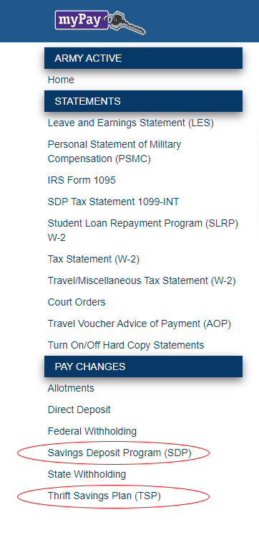
Savings Deposit Program (SDP)
Ensure contributions have stopped
Taxable interest earned up to 90 days after return
Withdrawals
  Contact myPay, email, fax, mail to DFAS
  Verify your bank routing and account numbers
  Automatic direct deposit after 120 days
  Visit https://www.dfas.mil/

Slide 21
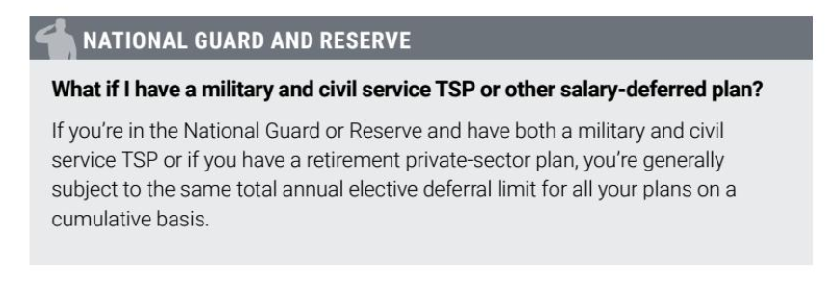
Thrift Savings Plan (TSP)
Combat Zone Tax Exclusion (CZTE)
Blended Retirement System (BRS)

Slide 22
Managing Debt and Credit

Slide 23

Financial Warning Signs
Living paycheck to paycheck
Unable to pay bills
Expensive purchases
No savings
Spouse lost job
Overwhelming debt
Preoccupied and being distant

Slide 24
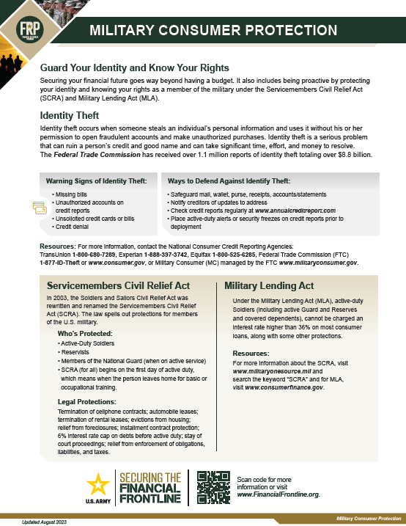
Military Consumer Protections
Notify lenders about deployment
Active-duty alert and security freeze
Review credit report
  Speak to a Personal Financial Manager/Counselor on your installation for credit questions
  Visit www.annualcreditreport.com
  Soldiers may request FREE credit monitoring from each of the reporting agencies
Know your rights
  Servicemembers Civil Relief Act (SCRA)
  Military Lending Act (MLA)
  Legal Office

Slide 25
Military Lending Act (MLA)
Who Is Protected?
  Active-duty service members
  Reserve and National Guard members on active duty for 30+ days
  Spouses and covered dependents
What Is Covered?
COVERED
NOT COVERED
Credit cards
Payday loans
Vehicle title loans
Refund anticipation loans
Certain installment loans
Certain student loans
Residential mortgages and refinances
Home equity loans
Auto loans secured by the vehicle
Personal property loans secured by the property

Slide 26








Servicemembers Civil Relief Act (SCRA)
SIX PERCENT INTEREST RATE
RESIDENTIAL LEASES
VEHICLE LEASES
FORECLOSURE & REPOSSESSION PROTECTION
EVICTION FROM HOUSING
COURT PROCEEDINGS
MOBILE PHONE CONTRACTS
RESIDENCE FOR STATE TAXES
01
02
03
04
05
Active-duty Soldiers
Members of the Guard/Reserve on federal active duty
Members of the National Guard on federal orders for a period of more than 30 days
Soldier dependents (in some situations)
Co-signers or those who took out loans with a Soldier (in some situations)
SOME PROTECTIONS EXTEND FOR A LIMITED TIME BEYOND ACTIVE-DUTY DISCHARGE OR RELEASE AND ARE TIED TO THE DISCHARGE OR RELEASE DATE.

Slide 27
Protect Your Credit Reputation
Active-duty alert and security freeze
  Good for one year, unless you remove sooner
  Must contact each of the three agencies to remove
Secure your information
  Follow Personally Identifiable Information (PII) regulations and procedures
  www.identitytheft.gov or www.consumer.gov
Review credit report
  www.annualcreditreport.com
  Take advantage of free credit monitoring

Slide 28
Summary and Resources

Slide 29
Summary
Welcome home from deployment!
Let’s wrap up all the topics we talked about today:
  Financial Planning
  Insurance and Legal Documents
  Saving and Investing
  Managing Debt and Credit
  Resources

Slide 30
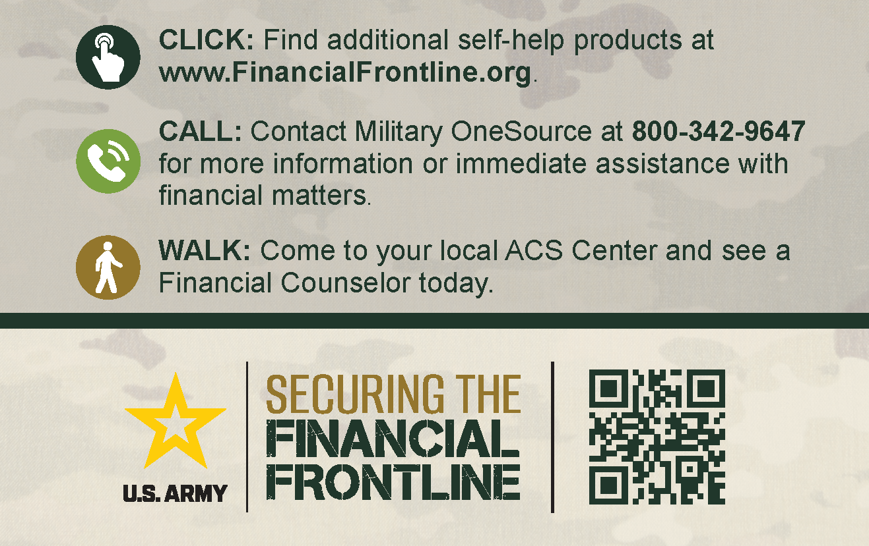
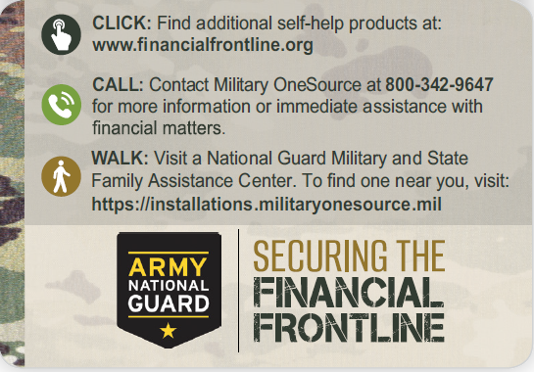
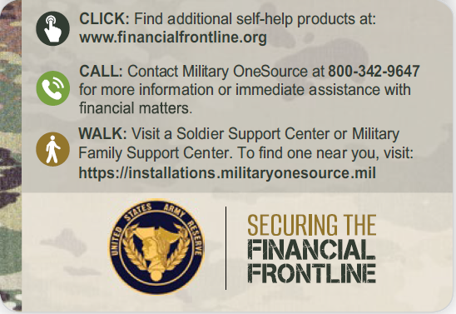
Resources and Conclusion

Slide 31
Thank You!

